Slide 1
Topics: SOA, XML Essentials, Web Services, Protocols, APIs

Slide 2
TABLE OF CONTENTS
SERVICE ORIENTED ARCHITECTURE (SOA)
Evolution of Software Architectures
SOA Fundamentals
Benefits
Challenges
SERVICE/API/MIDDLEWARE TESTING
Overview
Types of Service/API Testing
Testing Tools

Slide 3
TABLE OF CONTENTS
XML ESSENTIALS
XML & Related Technologies
XML Elements, Attributes, Namespace
XML & CSS
XML & DOM
XPath, XPath Nodes, Predicates
XSD
JSON ESSENTIALS
Datatypes
Comparison with XML

Slide 4
TABLE OF CONTENTS
SERVICES/APIS
Types of Web-Services (SOAP/REST)
WSDL, Endpoints, UDDI
SOAP Vs REST
TIBCO/JMS, Queues & Topics

Slide 5


Evolution of Software Architectures
Functionality
Login
Add, Update or Delete customer
Functionality
Login
Add, Update or Delete customer
Dot Net App User
Legacy Application User
Interface
IDL (OOPS)
CORBA (ORB)
Legacy Systems
Java App User
Web Service Interface
Web Services
Legacy System Interface
Dot Net App User
Functionality
Login
Add, Update or Delete customer
Java App User
Legacy Systems

Slide 6
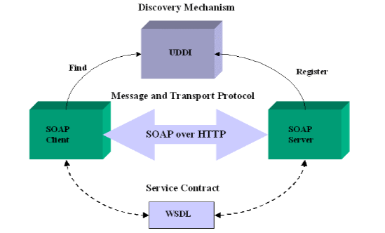
SERVICE ORIENTED ARCHITECTURE (SOA)
SOA Fundamentals
Communication:
A service-oriented architecture is essentially a collection of services which communicate with each other
The communication can involve either simple data passing or 2 or more services coordinating some activity
Loosely Coupled:
Service is a coarse grained executable unit of business functionality which is described by well defined interfaces and can be invoked remotely
Contract:
Service definition and messaging formats used for service invocation are based on mutually agreed open standards between service requestor and provider
Extensible:
SOA ensures reusability of individual software as services across multiple applications

Slide 7
SOA BENEFITS
Re-Use:
SOA is not about “Out the Old, in with the New”.
SOA is about Reuse.
Resolves redundancy problem – Many similar programs, especially after acquisitions.
With SOA you end with one single business service for a given function that gets used across organization.
Changes only have to be made in one place.
Cost:
Change & test only one service.
Contract:
Only one place where code change needs to be made and so change is implemented quickly.
Reduces Business Risk.
Errors limited to new developments, not in reuse of existing services.
Less re-work.

Slide 8
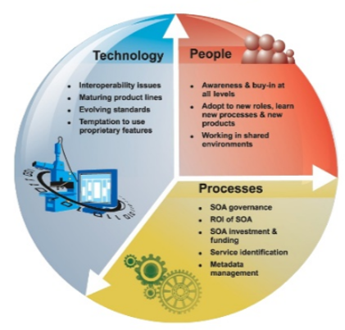
SOA CHALLENGES
Development & Maintenance:
Integration – Integration requires more configuration and has complexity.
Orchestration – Multiple service call in specific order to do a single task make this complicated.
Security – Open APIs are more prone to attacks.
Governance – Who, when and how to change/maintain.
SOA Testing:
No GUI – No traditional UI to test.
End to End Testing – Multi team involvement.
Security Testing – Large landscape.
Access – Restricted Access.

Slide 9
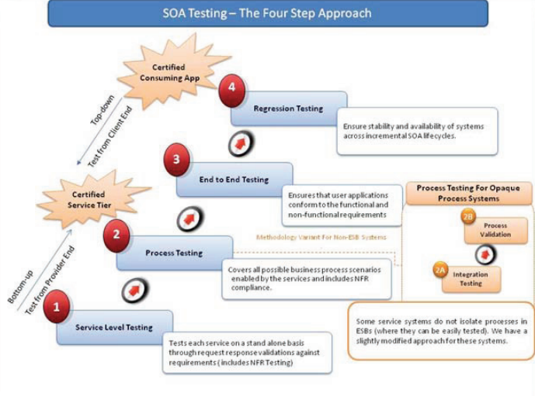
SERVICE/API TESTING
Overview:
Service/API testing is collection of methods and techniques employed to validate functionality of a component or group of components together.
API/Service have these common test performed on them -
Unit Testing
Integration testing
Functional Testing/System testing
End To End Testing
Regression Testing
Security Testing

Slide 10
TYPES OF SERVICE/API TESTING
API/Services Testing:
Unit testing - Testing the functionality of individual operations.
Functional testing - Testing the functionality of broader scenarios.
Regression Testing – Collection of test run to assure no adverse impact of change.
Load testing - Validating functionality and performance under load.
Security testing - Includes penetration testing and fuzz testing.
Web UI testing - Performed as part of end-to-end integration tests.
Primary API/Services Testing Tools:
CA DevTest
SOAPUI Basic & Pro
Parasoft
HP Service Test
IBM RIT

Slide 11
XML & Related Technologies
XML – eXtensible Markup Language:
XML is a markup language that defines a set of rules for encoding documents in a format that is both human-readable and machine-readable. The design goals of XML emphasize simplicity, generality, and usability across the Internet.
Tag based syntax similar to HTML
Allows to create custom tags (unlike HTML)
XHTML – HTML reformulated as XML; ensures strict HTML.
RSS/ATOM – XML format syndication to automatically share data (news feeds, blogs, podcasts, etc)
AJAX – Asynchronous JavaScript and XML
Web-Services – APIs over web
XML Related Technologies
XPath – eXtensible Path Language
XSLT – XML Stylesheet Language Transformations

Slide 12
XML Essentials – XML Elements (Tags)
An XML document contains XML elements
XML element is everything from element’s start tag to element’s end tag (inclusive)
Element can contain:
Text
Attributes
Other Elements
No content (known as Empty Element)
XML Naming Rules:
Case sensitive
Start with a letter or _ (underscore)
Cannot contain spaces
Cannot start with ‘xml’ (being a reserved keyword)
Example:
<player> <person>
<FirstName>Zlatan</FirstName> <LastName>Ibhrahimovich</LastName> </person>
<club>
<cname>Manchester United</cname>
<JerseyNo>07</JerseyNo>
</club> </player>
Structure is in form of :– Root ->Child->Sub Child & data structure is similar to a tree.

Slide 13
XML Essentials – XML Attributes
XML elements can have attributes
Attributes are designed to contain data related to a specific element
Attribute values must be quoted. Either single or double quotes can be used.
Attributes considerations:
Start with a letter or _ (underscore)
Cannot contain multiple values (elements can)
Cannot contain tree structures (elements can)
Example:
XML Elements Vs Attributes:
<person gender="female">
<firstname>Anna</firstname>
<lastname>Smith</lastname>
</person>
<person>
<gender>female</gender>
<firstname>Anna</firstname>
<lastname>Smith</lastname>
</person>
Attribute
Element

Slide 14
XML Essentials - Namespaces
XML Namespace:
XML namespaces are used to provide unique named elements and attributes in an XML document.
An XML instance may contain element or attribute names from more than one XML vocabulary. If each vocabulary is given a namespace, the ambiguity between identically named elements or attributes can be resolved.
Avoids Name conflicts (for developers) when XML documents are referred from different XML applications
XML Namespaces – The xmlns Attribute
The namespace can be defined by an xmlns attribute in the start tag of an element
The namespace declaration has the following syntax xmlns:prefix="URI"
Examples:
<root
xmlns:h="http://www.w3.org/TR/html4/"
xmlns:f="https://www.w3schools.com/furniture">
<h:table>
<h:tr>
<h:td>Apples</h:td>
<h:td>Bananas</h:td>
</h:tr>
</h:table>
<f:table>
<f:name>African Coffee Table</f:name>
<f:width>80</f:width>
<f:length>120</f:length>
</f:table>
</root>

Slide 15
XML Essentials – XML & CSS
CSS (Cascading Style Sheets):
CSS is a style sheet language used for describing the presentation of a document written in a markup language
XML documents can be associated with css to style XMLs
Not frequently used, since the XML is usually not used for display in front-end and primarily used for data exchange/communication
Examples:
products.xml:
<?xml version="1.0" encoding="UTF-8"?>
<?xml-stylesheet type="text/css" href="products.css"?>
<products>
<product id="p1" class="special">
<name>Delta</name>
<price>800</price>
<stock>4</stock>
<country>Denmark</country>
</product>
</products>
products.css:
products {font-size:80%; margin:0.5em; font-family: Verdana; display:block}
product {display:block; border: 1px solid silver; margin:0.5em; padding:0.5em}
name, price, stock, country {display:block}..........

Slide 16
XML Essentials – XML & DOM
DOM (Document Object Model):
The W3C Document Object Model (DOM) is a platform and language-neutral interface that allows programs and scripts to dynamically access and update the content, structure, and style of a document.
DOM represents tree structure and contents are referred as nodes.
The XML DOM defines a standard way for accessing and manipulating XML documents. It presents an XML document as a tree-structure.
DOM is an interface and implementations are available in several languages: JavaScript, Java, Python, etc
Examples:
<?xml version="1.0" encoding="UTF-8"?>
<bookstore>
<book category="cooking">
<title lang="en">Everyday Italian</title>
<year>2005</year>
<price>30.00</price>
</book>
<book category="children">
<title lang="en">Harry Potter</title>
<year>2005</year>
<price>29.99</price>
</book>
</bookstore>
JavaScript:
var x = xmlDoc.getElementsByTagName("title");
for (i = 0; i <x.length; i++) {
// do something for each node }
DOM method implemented in JavaScript

Slide 17
XML Essentials - XPath
XPath – XML Path Language (W3C recommendation):
XPath (XML Path Language) is a query language for selecting nodes from an XML document. In addition, XPath may be used to compute values (e.g., strings, numbers, or Boolean values) from the content of an XML document.
It is part of XSL (Extensible Stylesheet Language) W3C family of recommendations. It is similar to CSS with HTML.
XPath uses path expressions to select nodes or node-sets in an XML document. The node is selected by following a path or steps.

Slide 18
XML Essentials – Selecting Nodes in XPath
XPath uses path expressions to select nodes in an XML document
vehiclesList | Selects all nodes with the name “vehiclesList”
/vehiclesList | Selects the root element vehiclesList
vehiclesList/vehicle | Selects all vehicle elements that are children of vehiclesList
//vehicle | Selects all vehicle elements no matter where they are in the document
vehiclesList//vehicle | Selects all vehicle elements that are descendant of the vehiclesList element, no matter where they are under the vehiclesList element
//@VIN | Selects all attributes that are named VIN
<?xml version="1.0" encoding="UTF-8"?>
<vehiclesList>
<vehicle>
<make VIN="1HGCM82633A004352">Ford Echo</make>
<year>2014</year>
</vehicle>
<vehicle>
<make VIN="1NGRM52582K654971">Honda Accord</make>
<year>2015</year>
</vehicle>
</vehiclesList>

Slide 19
XML Essentials - XPath Predicates
Predicates are used to find a specific node or a node with a specific value. Predicates are embedded in square brackets.
/vehiclesList/vehicle[1] | Selects the first vehicle element that is the child of the vehiclesList element
/vehiclesList/vehicle[last()] | Selects the last vehicle element that is the child of the vehiclesList element
//make[@VIN] | Selects all make elements that have an attribute named VIN
//make[@VIN=“1NGRM52582K654971”] | Selects all make elements that have a “VIN" attribute with a value of "1NGRM52582K654971"
/vehiclesList/vehicle[year>2014] | Selects all vehicle elements of vehiclesList element that have a year element with value greater than 2014
/vehiclesList/vehicle[year>2013]/make | Selects all make elements of the vehicle elements of vehiclesList element that have a year element with value greater than 2013
<?xml version="1.0" encoding="UTF-8"?>
<vehiclesList>
<vehicle>
<make VIN="1HGCM82633A004352">Ford Echo</make>
<year>2014</year>
</vehicle>
<vehicle>
<make VIN="1NGRM52582K654971">Honda Accord</make>
<year>2015</year>
</vehicle>
</vehiclesList>

Slide 20
XML Essentials – Selecting Unknown Nodes in XPath
Wildcards are used to select unknown XML Nodes
<?xml version="1.0" encoding="UTF-8"?>
<vehiclesList>
<vehicle>
<make VIN="1HGCM82633A004352">Ford Echo</make>
<year>2014</year>
</vehicle>
<vehicle>
<make VIN="1NGRM52582K654971">Honda Accord</make>
<year>2015</year>
</vehicle>
</vehiclesList>
/vehiclesList/* | Selects all the child element nodes of the vehiclesList element
//* | Select all the elements in a document
//make[@*] | Selects all make elements which have at least one attribute of any kind

Slide 21
XML Essentials – Selecting Multiple Paths
| operator is used in XPath expression to select several paths
<?xml version="1.0" encoding="UTF-8"?>
<vehiclesList>
<vehicle>
<make VIN="1HGCM82633A004352">Ford Echo</make>
<year>2014</year>
</vehicle>
<vehicle>
<make VIN="1NGRM52582K654971">Honda Accord</make>
<year>2015</year>
</vehicle>
</vehiclesList>
//vehicle/make | //vehicle/year | Selects all the make AND year elements of all vehicle elements
//make | //year | Selects all the make AND year elements in the document
/vehiclesList/vehicle/make | //year | Selects all the make elements of the vehicle element of the vehiclesList element AND all the year elements in the document

Slide 22
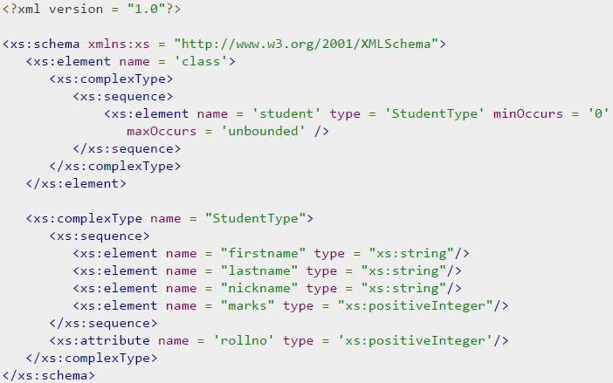
XML Essentials - XSD
XSD – XML Schema Definition :
XML Schema Definition commonly known as XSD is a way to describe precisely the XML language. XSDs check the validity of structure and vocabulary of an XML document against the grammatical rules of the appropriate XML language.
An XML document can be defined as −
Well-formed − If the XML document adheres to all the general XML rules such as tags must be properly nested, opening and closing tags must be balanced, and empty tags must end with '/>', then it is called as well-formed.
OR
Valid − An XML document said to be valid when it is not only well-formed, but it also conforms to available XSD that specifies which tags it uses, what attributes those tags can contain, and which tags can occur inside other tags, among other properties.

Slide 23
JSON Essentials
JSON – JavaScript Object Notation:
Is a text-based, lightweight and human-readable format for data exchange between clients and servers
JSON is a format, not a language
While it is derived from JavaScript, it is not dependent on JavaScript
In addition to JavaScript engines, several programming languages supporting service-oriented architecture supports JSON processing
Keys and Values:
The two primary parts that make up JSON are keys and values. Together they make a key/value pair.
Key: A key is a string enclosed in quotation marks
Value: A value can be a string, number, boolean expression, array or object
Key/Value Pair: A key value pair follows a specific syntax, with the key followed by a colon followed by the value. Key/value pairs are comma separated.
Example: "foo" : "bar"

Slide 24
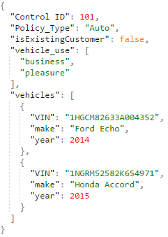
JSON Essentials – Datatypes
Datatype | Snippet
Numbers | "Control ID":101
Strings | "Policy_Type":"Auto"
Booleans | "isExistingCustomer":false
Arrays | "vehicle_use":[ "business", "pleasure" ]
Objects | "vehicles":{ "VIN":"1HGCM82633A004352", "make":"Ford Echo", "year":2014 }

Slide 25
JSON Essentials – Comparison with XML
JSON is lightweight compared to XML
XML can be validated through XSDs. No validation for JSON.
Requires scripts (say, JavaScript) to parse XML objects. Whereas, JSON itself is a JavaScript object. JSON evaluation is faster compared to XML parsing.
JSON is better suited for atomic values, whereas XML is suited for well-formed, mixed content datasets

Slide 26
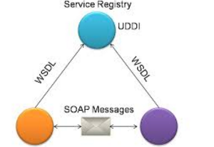
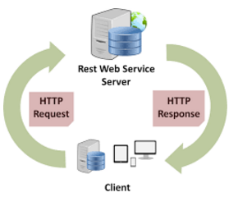
WEB SERVICES
Definition:
A web service is a service offered by an electronic device to another electronic device, communicating with each other via the World Wide Web.
In a Web service, Web technology such as HTTP, originally designed for human-to-machine communication, is utilized for machine-to-machine communication, more specifically for transferring machine readable file formats such as XML and JSON.
It can be thought as piece of software available over network that can send/receive messages in standard formats.
For example, a client invokes a web service by sending an XML message, then waits for a corresponding XML response. As all communication is in XML, web services are not tied to any one operating system or programming language--Java can talk with Perl; Windows applications can talk with Unix applications.

Slide 27
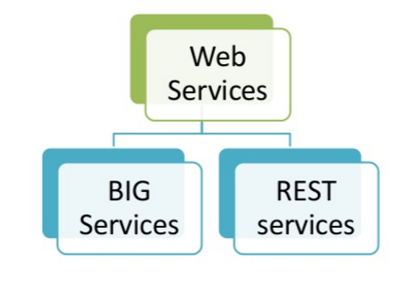
TYPES OF WEB SERVICES
Category: Primarily of 2 types
SOAP (BIG) Services:
A web service that is implemented following SOAP(Simple Object Access Protocol) protocol is a SOAP based service. It uses XML as messaging standard to communicate, and all messages are placed within SOAP envelope – Which follows a header/body model.
SOAP services primarily use http(s) protocol for communication but do support other protocols.
RESTful Services:
A web service that is implemented following REST(Representational State Transfer) architecture pattern is a REST based service. It uses JSON/XML as messaging standard to communicate, but do support other data formats.
REST services fully utilize use http(s) protocol stack for communication.

Slide 28
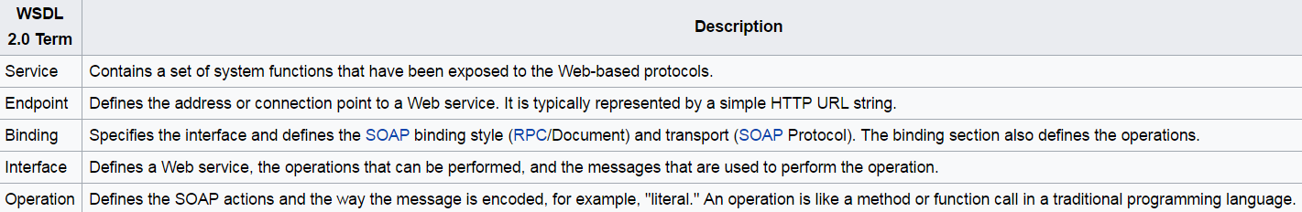
WSDL
WSDL – Web Services Description Language :
The Web Services Description Language is an XML-based interface definition language that is used for describing the functionality offered by a web service. The acronym is also used for any specific WSDL description of a web service (also referred to as a WSDL file), which provides a machine-readable description of how the service can be
called, what parameters it expects, and what data structures it returns. Therefore, its purpose is roughly similar to that of a method signature in a programming language. The current version of WSDL is WSDL 2.0.
Sample WSDL File:

Slide 29
ENDPOINTS
Endpoint –
The Web service endpoint is the port upon which you connect a Web service client to the Orchestrator server.
Example:
https://lxv2789:16786/MIRCService/ServiceAgents/MaintainIdentityRelationships.serviceagent/icsMaintainIdentityRelationshipsEndpoint/V2.2
HTTP –
HTTP is short for HyperText Transfer Protocol. HTTP is the underlying protocol used by the World Wide Web and this protocol defines how messages are formatted and transmitted, and what actions Web servers and browsers should take in response to various commands.
Methods –
POST ->Create
GET ->Read
PUT ->Update( Idempotence )
DELETE ->Delete

Slide 30
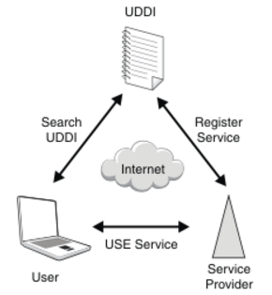
UDDI
UDDI –Universal Description, Discovery, and Integration.
UDDI is an XML-based standard for describing, publishing, and finding web services.
Used For -
UDDI is a specification for a distributed registry of web services.
UDDI is a platform-independent, open framework.
UDDI can communicate via SOAP, CORBA, Java RMI Protocol.
UDDI uses Web Service Definition Language(WSDL) to describe interfaces to web services.

Slide 31
JMS
JMS –Java Message Service
The Java Message Service (JMS) API is a Java Message Oriented Middleware (MOM) API for sending messages between two or more clients. It is an implementation to handle the Producer-consumer problem. It is a messaging standard that allows application components based on the Java Enterprise Edition (Java EE) to create, send, receive, and read messages.
It allows the communication between different components of a distributed application to be loosely coupled, reliable, and asynchronous.
The following are JMS elements:
JMS provider - An implementation of the JMS interface for a Message Oriented Middleware (MOM). Providers are implemented as either a Java JMS implementation or an adapter to a non-Java MOM.
JMS client - An application or process that produces and/or receives messages.
JMS producer/publisher - A JMS client that creates and sends messages.
JMS consumer/subscriber - A JMS client that receives messages.
JMS message - An object that contains the data being transferred between JMS clients.
JMS queue - A staging area that contains messages that have been sent and are waiting to be read (by only one consumer).
JMS topic - A distribution mechanism for publishing messages that are delivered to multiple subscribers.

Slide 32
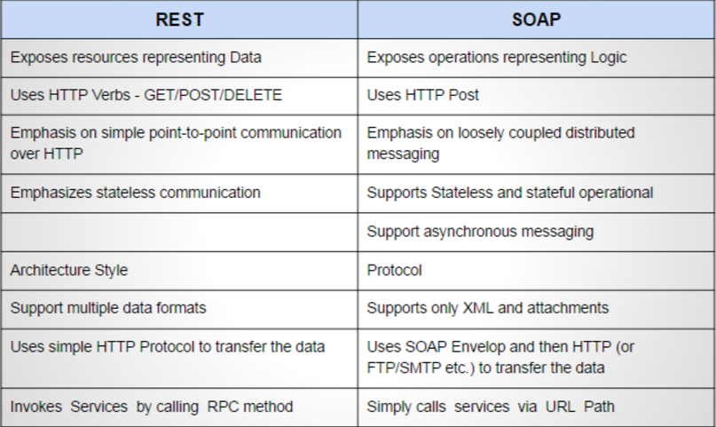
REST & SOAP Comparison

Slide 33

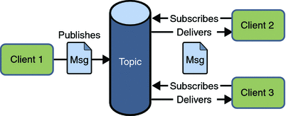
TIBCO, JMS, QUEUES & TOPICS
Queue –
Topic -
TIBCO:
Provides infrastructure software focuses on real-time communication for business-to-business, business-to-consumer and business-to-employee data transfers, including facilitation of communication between otherwise incompatible software. The company provides middleware, which allows for access to real-time data between multiple systems while predicting users' needs.
JMS:
The Java Message Service (JMS) API is a Java Message Oriented Middleware (MOM) API for sending messages between two or more clients.
Queue - A staging area that contains messages that have been sent and are waiting to be read (by only one consumer).
Topic - A distribution mechanism for publishing messages that are delivered to multiple subscribers.

Slide 34
Thank you.

